Slide 1
EdgeX analysis
Khemendra kumar
Version: v1.0

Slide 2
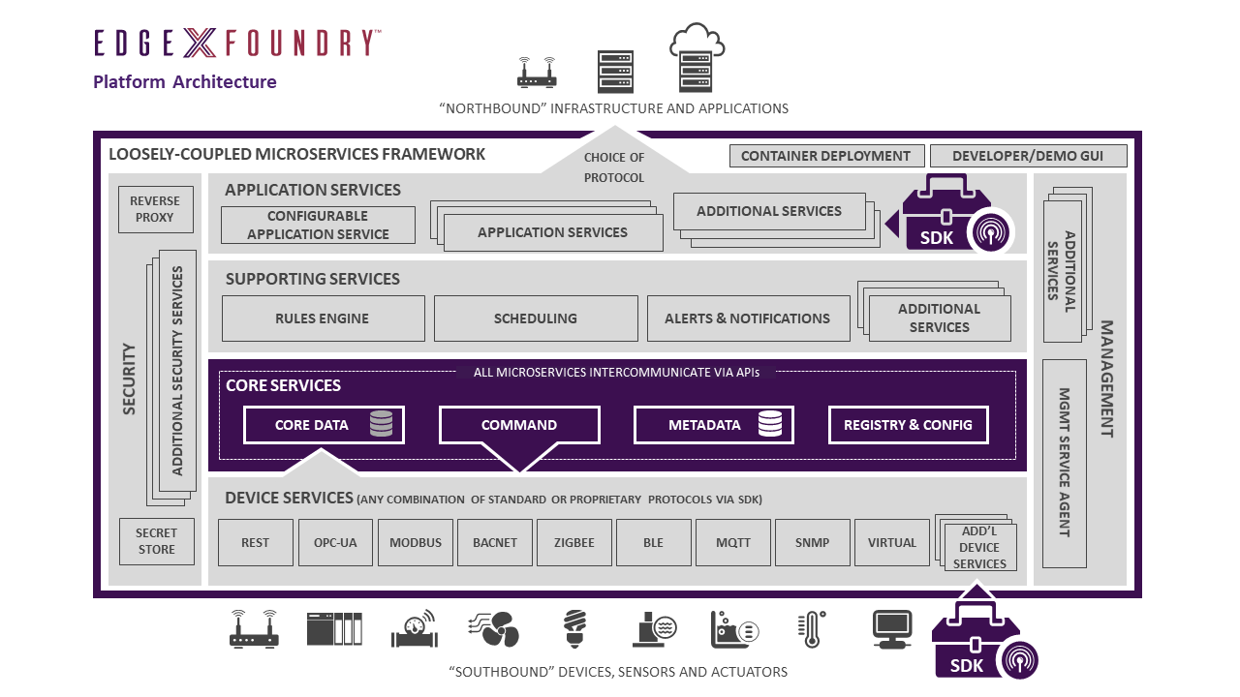
EdgeX Architecture
Loosely coupled microservices with distributed architecture for collect data from different IOT devices and send to cloud. Has supported multiple IOT protocols and Cloud providers and these can quickly extend by provided Device and application service SDKs for new IOT protocols/devices and new North side Cloud/system.
The 4 Service Layers of EdgeX Foundry are as follows:
Core Services Layer
Supporting Services Layer
Application Services Layer
Device Services Layer
The 2 underlying System Services of EdgeX Foundry are as follows:
Security
System Management
EdgeX is mostly written in Go and C
Notes:
https://docs.edgexfoundry.org/2.0/

Slide 3
Core Services
Core service layer contains 4 microservices
Core data: a persistence repository and associated management service for data collected from south side objects.
Command: a service that facilitates and controls actuation requests from the north side to the south side.
Metadata: a repository and associated management service of metadata about the objects that are connected to EdgeX Foundry. Metadata provides the capability to provision new devices and pair them with their owning device services.
Registry and Configuration: provides other EdgeX Foundry micro services with information about associated services within EdgeX Foundry and micro services configuration properties (i.e. - a repository of initialization values).

Slide 4
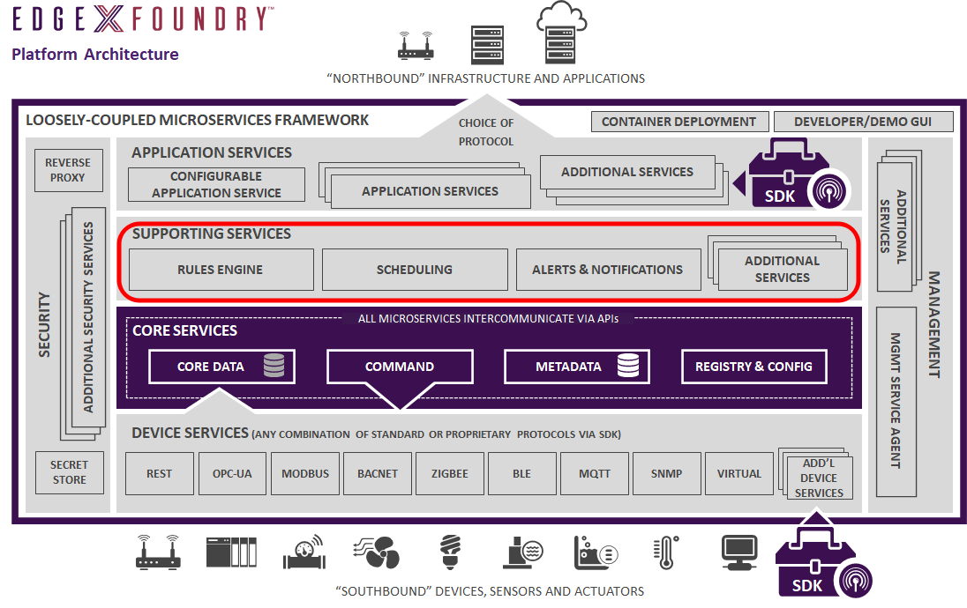
Supporting and application service
Supporting service:
Rules Engine: the reference implementation edge analytics service that performs if-then conditional actuation at the edge based on sensor data collected by the EdgeX instance.
Scheduling: an internal EdgeX “clock” that can kick off operations in any EdgeX service. At a configuration specified time, the service will call on any EdgeX service API URL via REST to trigger an operation. For example, the scheduling service periodically calls on core data APIs to clean up old sensed events that have been successfully exported out of EdgeX.
Alerts and Notifications: provides EdgeX services with a central facility to send out an alert or notification. These are notices sent to another system or to a person monitoring the EdgeX instance .
Application service:
Application services are the means to extract, process/transform and send sensed data from EdgeX to an endpoint or process of your choice.
Provide application service examples to send data to many of the major cloud providers (Amazon IoT Hub, Google IoT Core, Azure IoT Hub, IBM Watson IoT…), to MQTT(s) topics, and HTTP(s) REST endpoints.

Slide 5
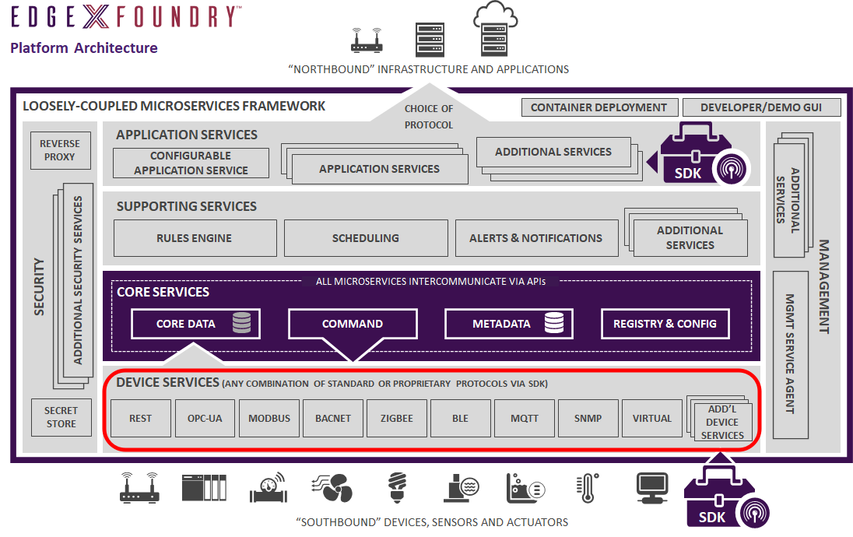
Device services
Device services may service one or a number of things or devices (sensor, actuator, etc.) at one time.
Communicates with the devices, sensors, actuators, and other IoT objects through protocols native to each device object.
Converts the data produced and communicated by the IoT object into a common EdgeX Foundry data structure, and sends that converted data into the core services layer, and to other micro services in other layers of EdgeX Foundry.

Slide 6
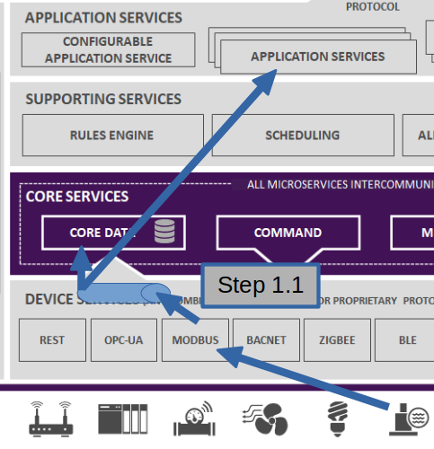
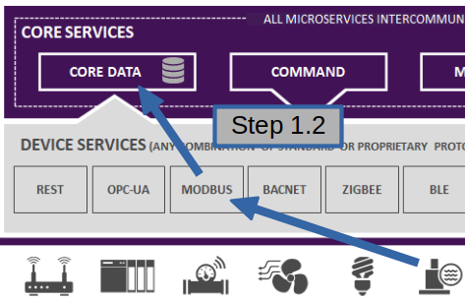
Data Flow in EdgeX
Sensor Data Collection:
The device service translates the sensor data into an EdgeX event object. The device service can then either:
put the event object on a message bus (which may be implemented via Redis Streams or MQTT). Subscribers to the event message on the message bus can be application services or core data or both
send the event object to the core data service via REST communications.

Slide 7
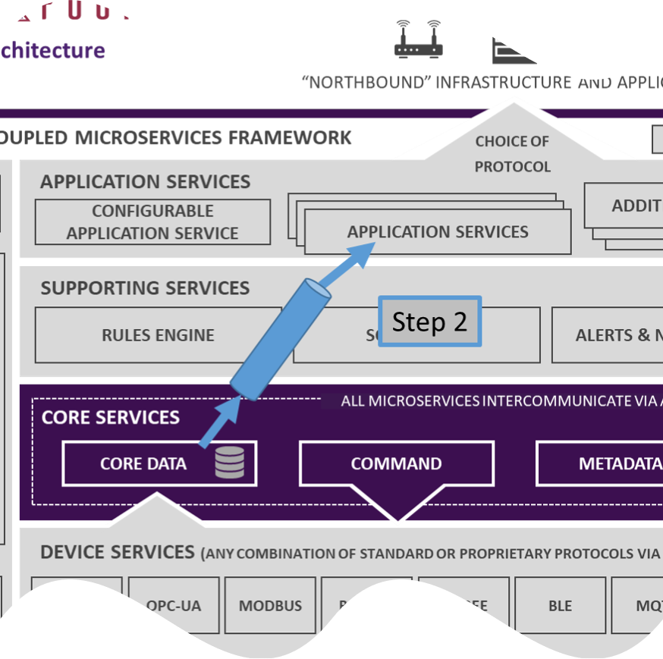
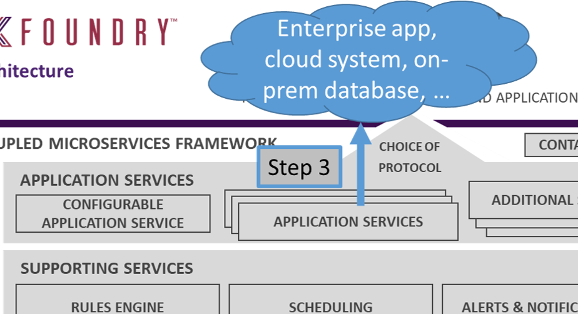
Conti.
Data to Applications: step 2
When core data receives event objects from the device service via REST, it will put sensor data events on a message topic destined for application services.
Redis Pub/Sub is used as the messaging infrastructure by default (step 2). MQTT or ZMQ can also be used as the messaging infrastructure between core data and the application services.
Data to Cloud: step 3
The application service transforms the data as needed and pushes the data to an endpoint.
It can also filter, enrich, compress, encrypt or perform other functions on the event before sending it to the endpoint
The endpoint could be an HTTP/S endpoint, an MQTT topic, a cloud system (cloud topic), etc.

Slide 8
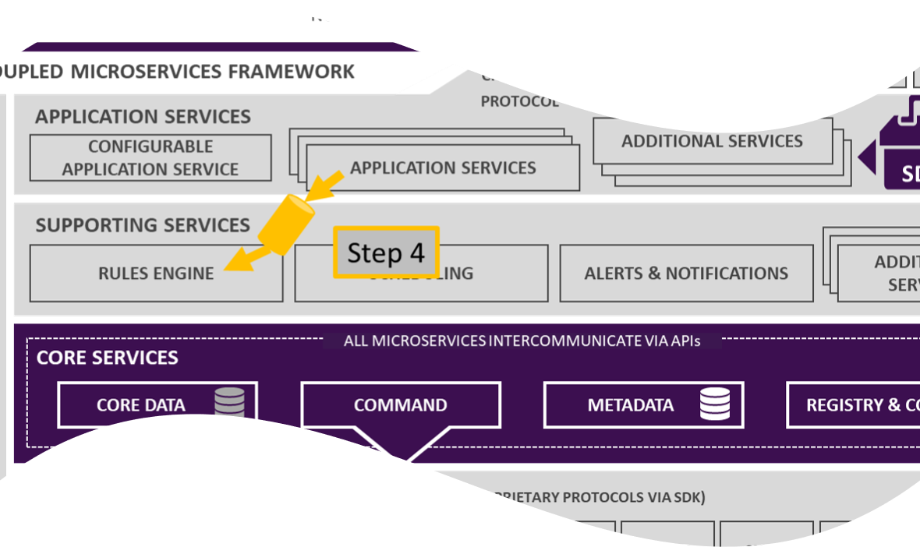
Data from Application service to Rules engine
Just as application services prepare data for consumption by north side cloud systems or applications, application services can process and get EdgeX events to any analytics package.
By default, EdgeX ships with a simple rules engine (the default EdgeX rules engine is Kuiper – an open source rules engine by EMQ X).
Application service pub data event to zeroMQ which is SUB by rules engine

Slide 9
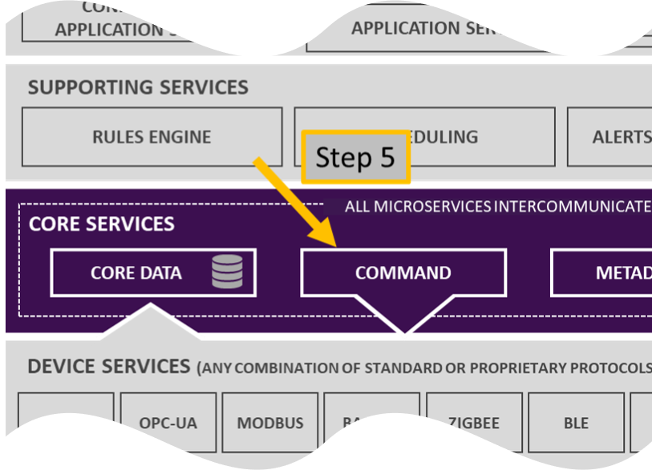
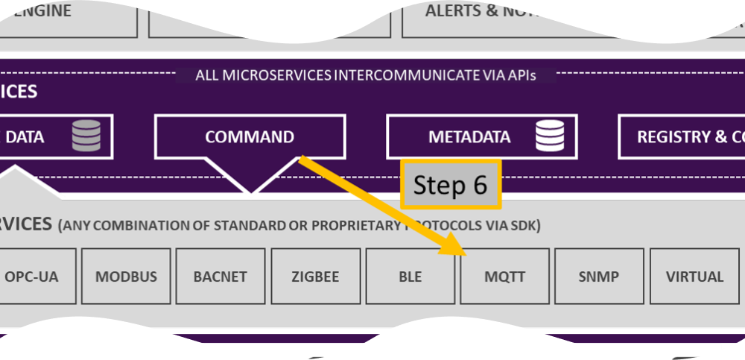
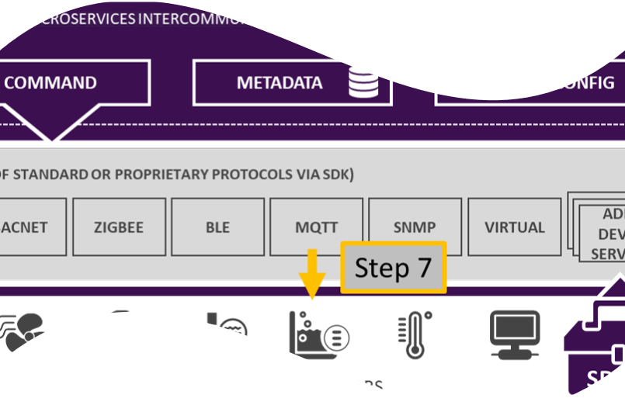
Data from Rules engine to device actuations
The analytic package can explore the sensor event data and make a decision to trigger actuation of a device.
The core command service gets the actuation request and determines which device it needs to act on with the request; then calling on the owning device service to do the actuation
The device service receives the request for actuation, translates that into a protocol specific request and forwards the request to the desired device

Slide 10
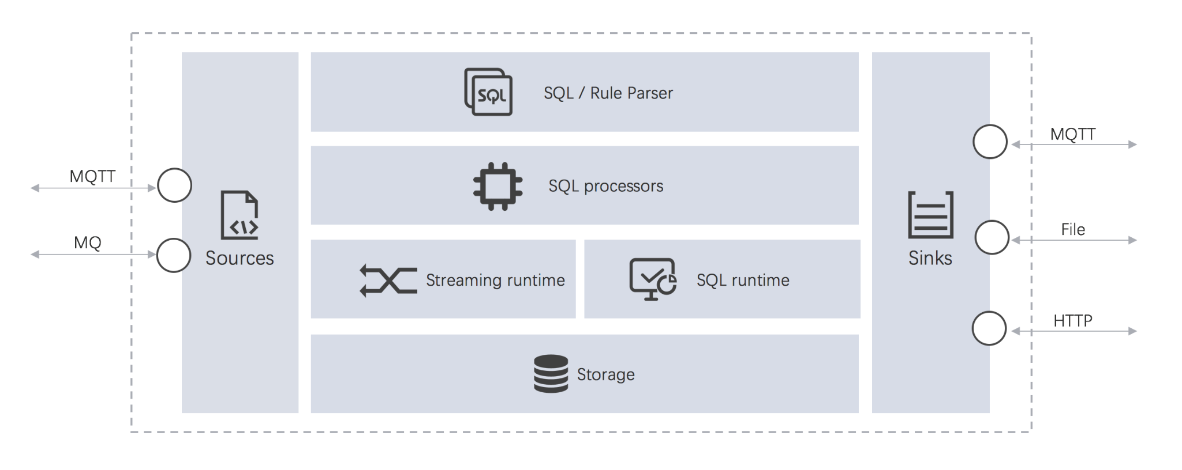
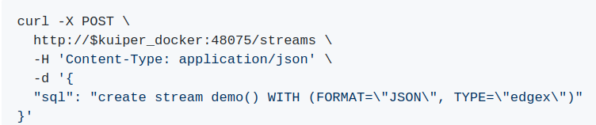
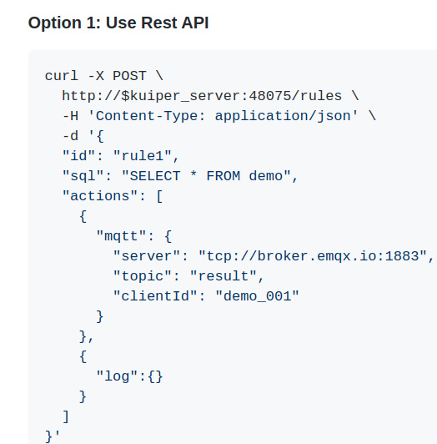
Rules engine rule config
Following three steps are required for using eKuiper.
Create a stream, where you specify the data source.
Write a rule.
Write a SQL for data analysis
Specify a sink target for saving analysis result
Deploy and run rule.
Set source
Apply rule and take action
Notes:
https://github.com/lf-edge/ekuiper/blob/master/docs/en_US/edgex/edgex_rule_engine_tutorial.md

Slide 11
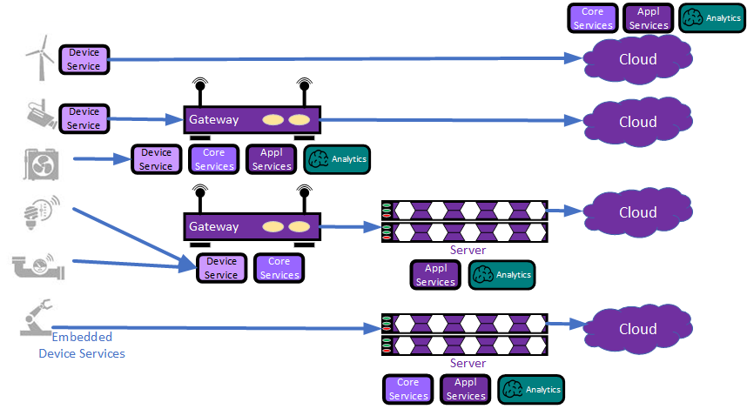
EdgeX distributed deployment
Its loosely-coupled architecture enables distribution across nodes to enable tiered edge computing.
For example, thing communicating services could run on a programmable logic controller (PLC), a gateway, or be embedded in smarter sensors while other EdgeX services are deployed on networked servers or even in the cloud. The scope of a deployment could therefore include embedded sensors, controllers, edge gateways, servers and cloud systems.

Slide 12
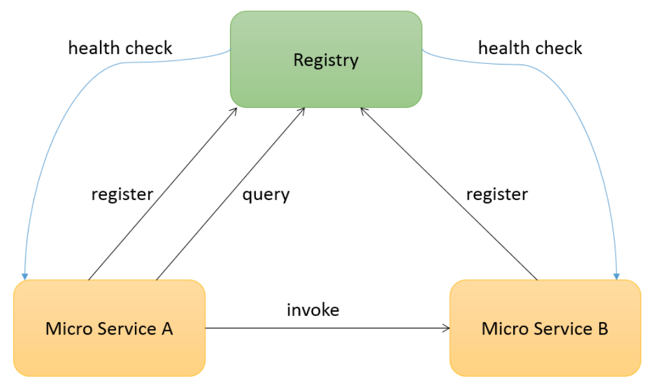
Service registry - consul
Consul is used for service registry:
To enable micro services to find and to communicate with each other.
When micro service starts up, it registers itself with the registry, and the registry continues checking its availability periodically via a specified health check endpoint.
When one micro service needs to connect to another one, it connects to the registry to retrieve the available host name and port number of the target micro service and then invokes the target micro service.

Slide 13
Overview of EdgeX services

Slide 14
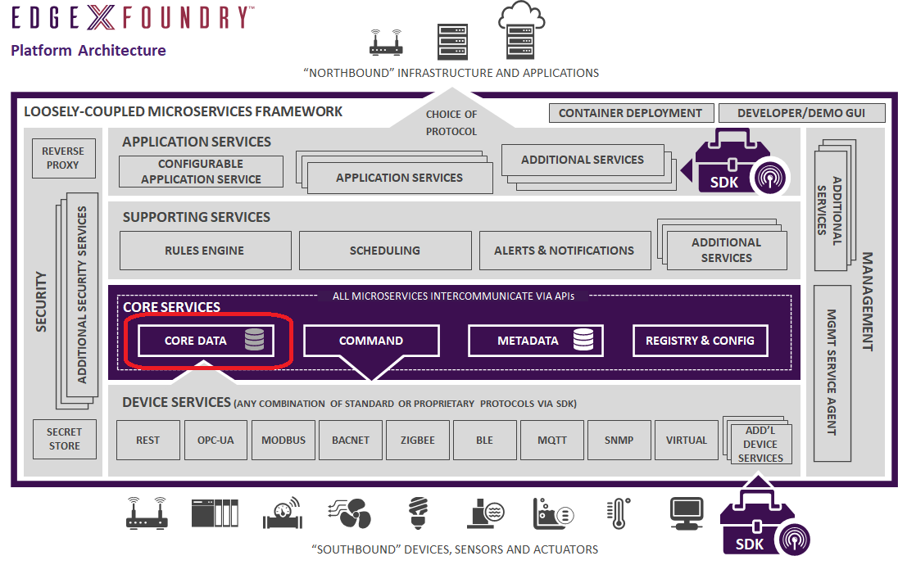
Core Data service
Device services call on the core data service to store the sensor data until the data gets moved "north" and then exported to Enterprise and cloud systems.
Redis is used by default, but a database abstraction layer allows for other databases to be used.
Core data has a REST API for moving data into and out of the local storage.
Core data moves data to the application service (and edge analytcs) via ZeroMQ by default

Slide 15
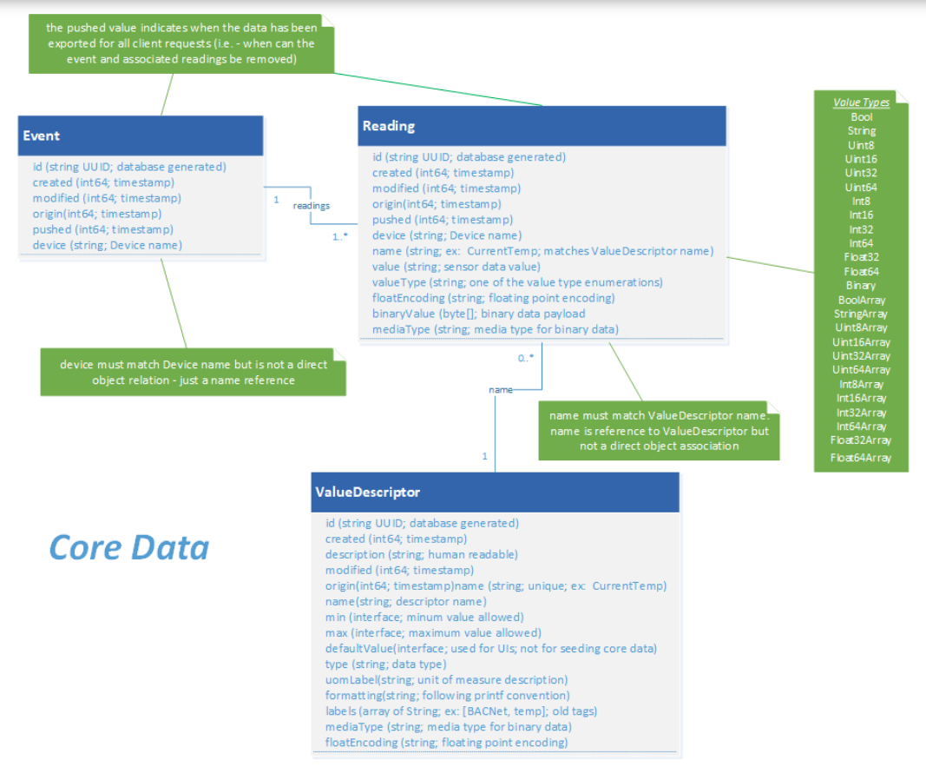
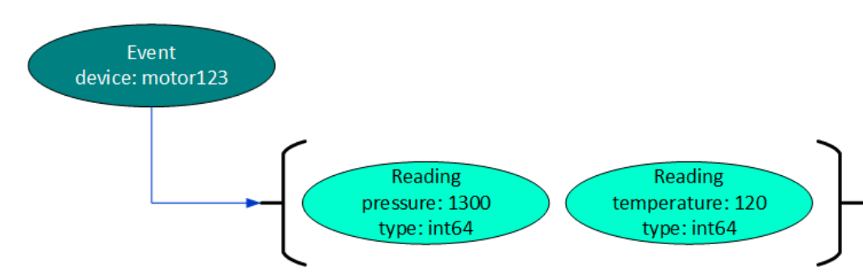
Event and readings data model
Data collected from sensors is marshalled into EdgeX event and reading objects (delivered as JSON objects in service REST calls to core data).
An event represents a collection of one or more sensor readings.
Some sensors or devices are only providing a single value – a single reading - at a time. Other sensors spew multiple values whenever they are read.

Slide 16
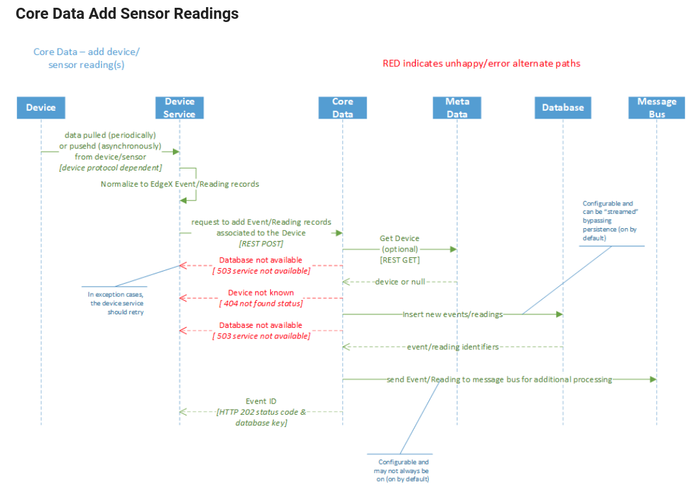
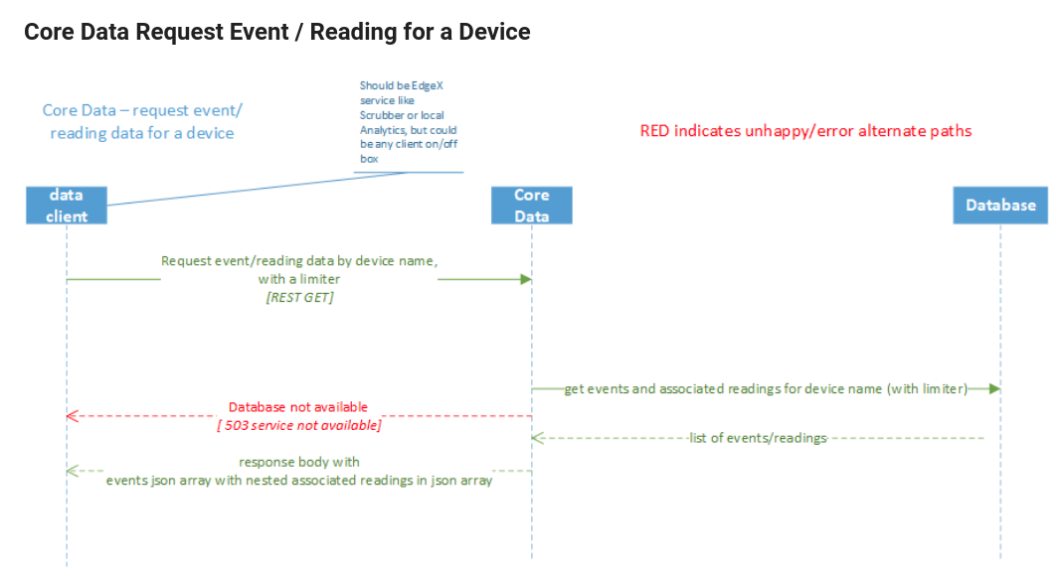
Core data Interaction with devices and Applications

Slide 17
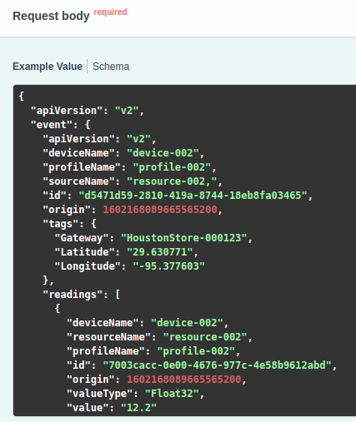
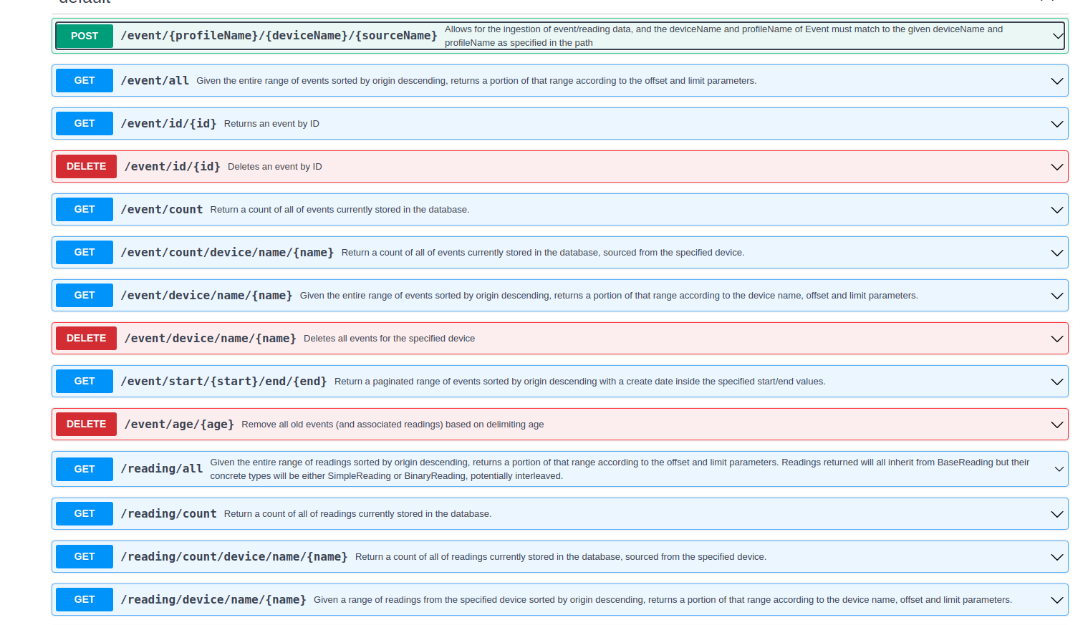
Core data APIs
Notes:
https://app.swaggerhub.com/apis-docs/EdgeXFoundry1/core-data/2.0.0#/default/get_event_all

Slide 18
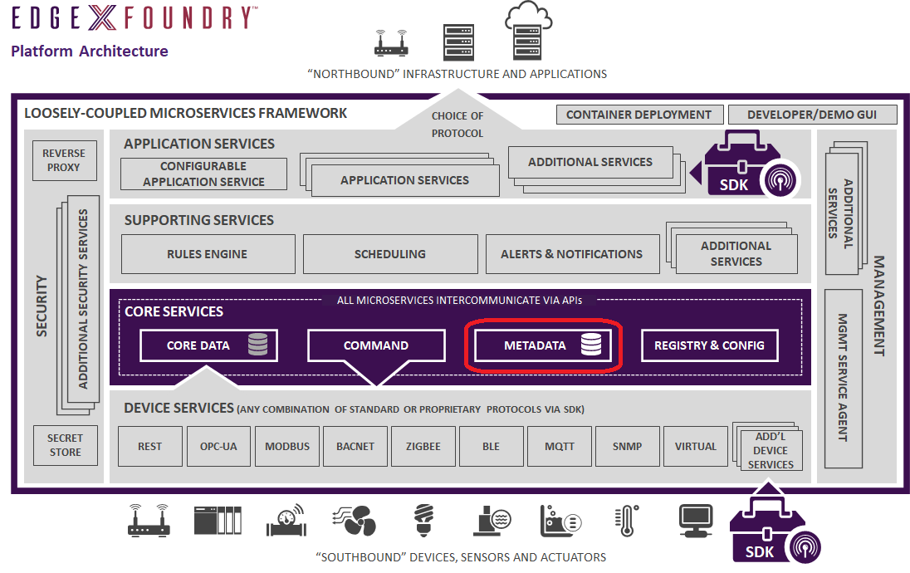
Metadata service
It has knowledge about the devices and sensors and how to communicate with them used by the other services, such as core data, core command, and so forth.
Specifically, metadata has the following abilities:
Manages information about the devices connected to, and operated by, EdgeX Foundry
Knows the type, and organization of data reported by the devices
Knows how to command the devices

Slide 19
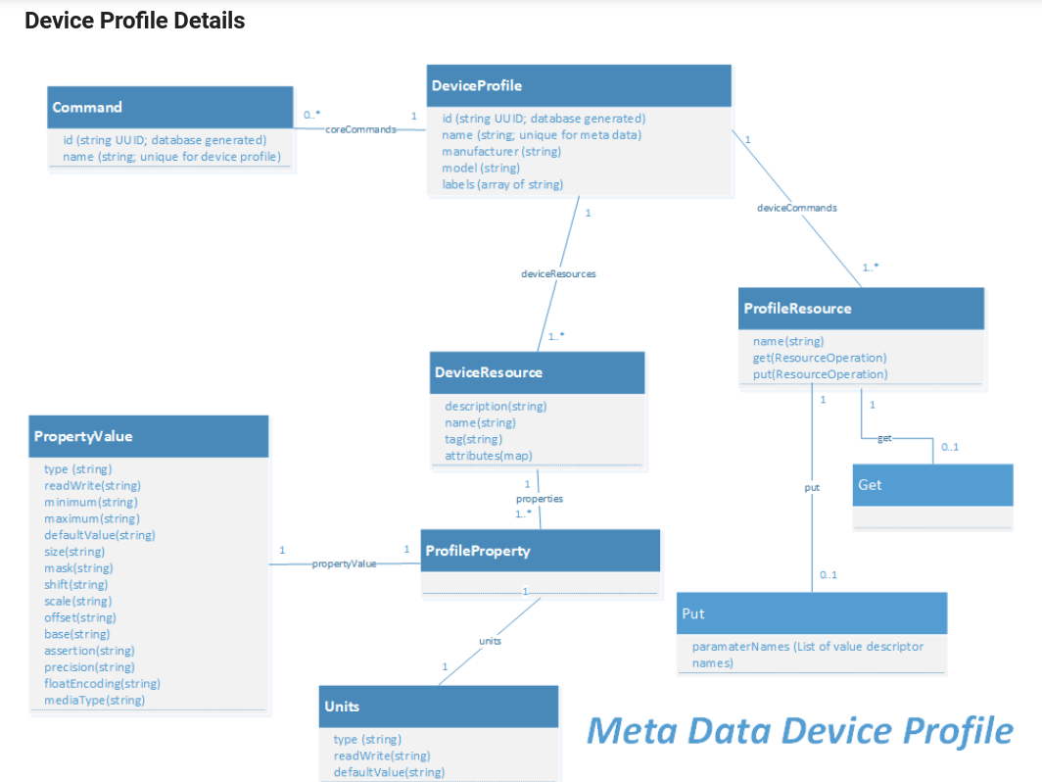
Data Models: Device profile
Device profiles define general characteristics about devices, the data they provide, and how to command them.
It also defines which types of commands or actions EdgeX can send to the BACnet thermostat
Device profiles are typically specified in YAML file and uploaded to EdgeX

Slide 20
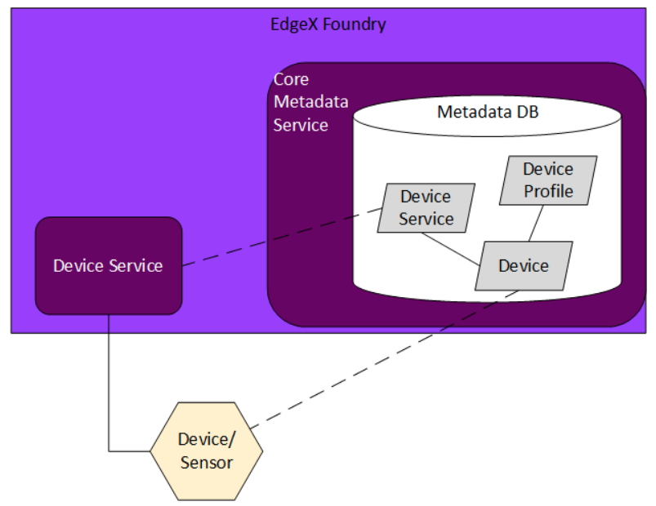
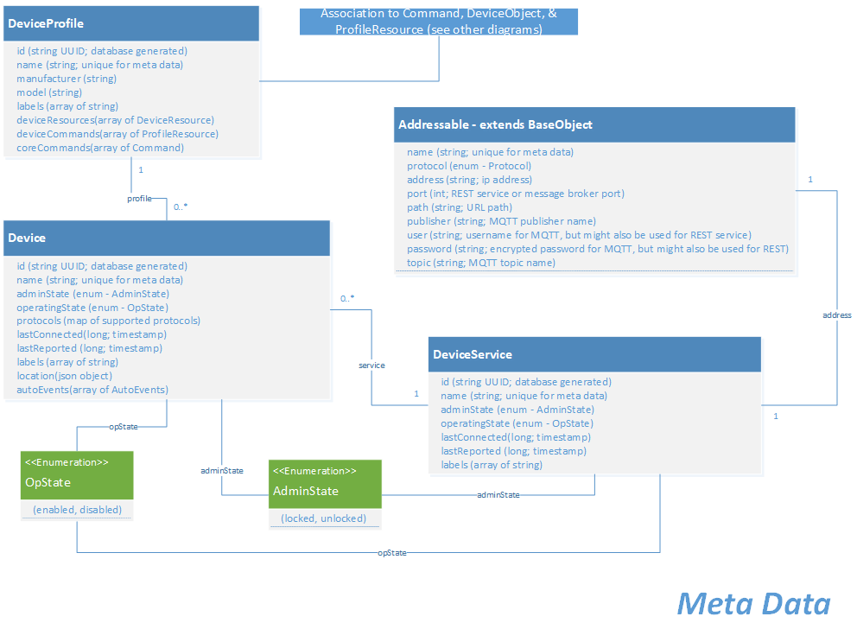
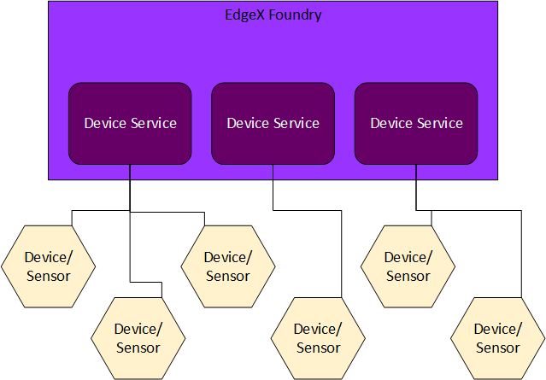
Device service registration with metadata
When a device service starts, it registers itself with metadata. When EdgeX provisions a new devices the device gets associated to its owning device service. That association is also stored in metadata.

Slide 21
Device Provisioning: Provision Watcher
Static Provisioning: a device service may be provided with the specific IP address and additional device details for a device (or devices) that it is to onboard at startup. In static provisioning, it is assumed that the device will be there and that it will be available at the address or place specified through configuration. The devices and the connection information for those devices is known at the point that the device service starts.
Dynamic Provisioning: Device service may be given a range of BLE address space and told to look for devices of a certain nature in this range. However, the device service does not know that the device is physically there – and the device may not be there at start up. It must continually scan during its operations (typically on some sort of schedule) for new devices within the guides of the location and device parameters provided by configuration.
A provision watcher, is specific configuration information provided to a device service (usually at startup) that gets stored in metadata. In addition to providing details about what devices to look for during a scan, a provision watcher may also contain “blocking” indicators, which define parameters about devices that are not to be automatically provisioned.

Slide 22
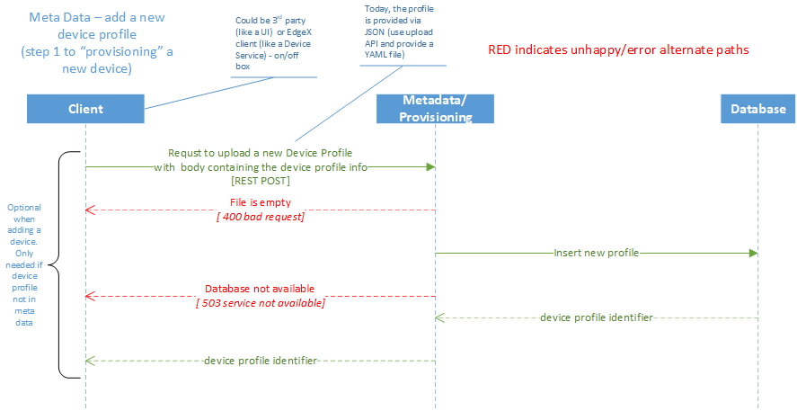
Add a New Device Profile (Step 1 to provisioning a new device)

Slide 23
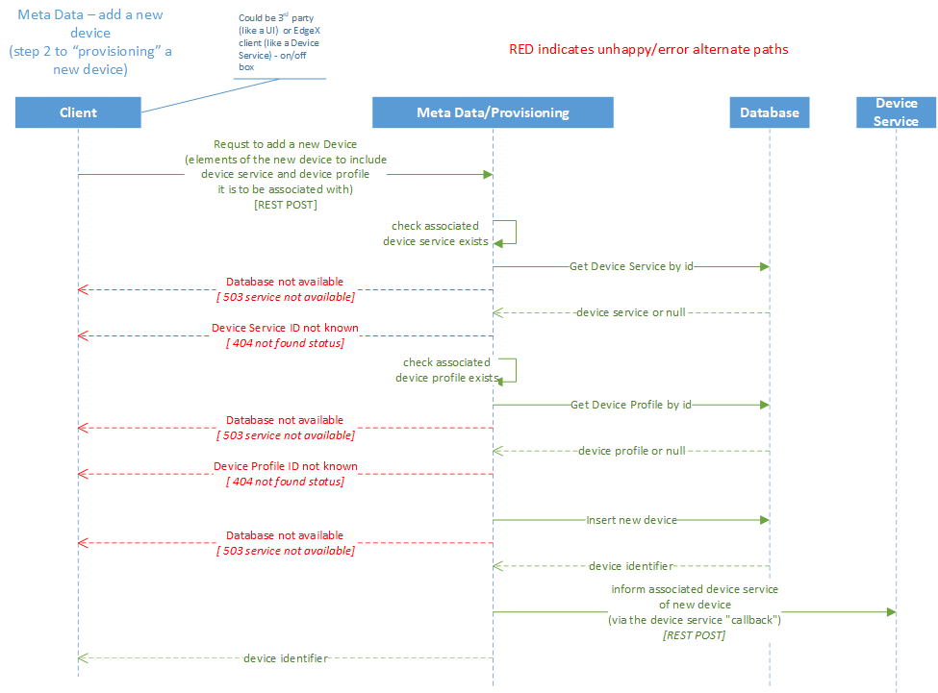
Add a New Device (Step 2 to provisioning a new device)

Slide 24
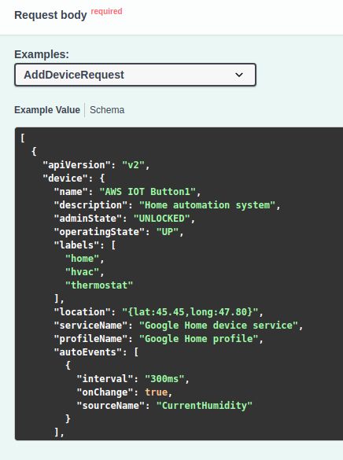
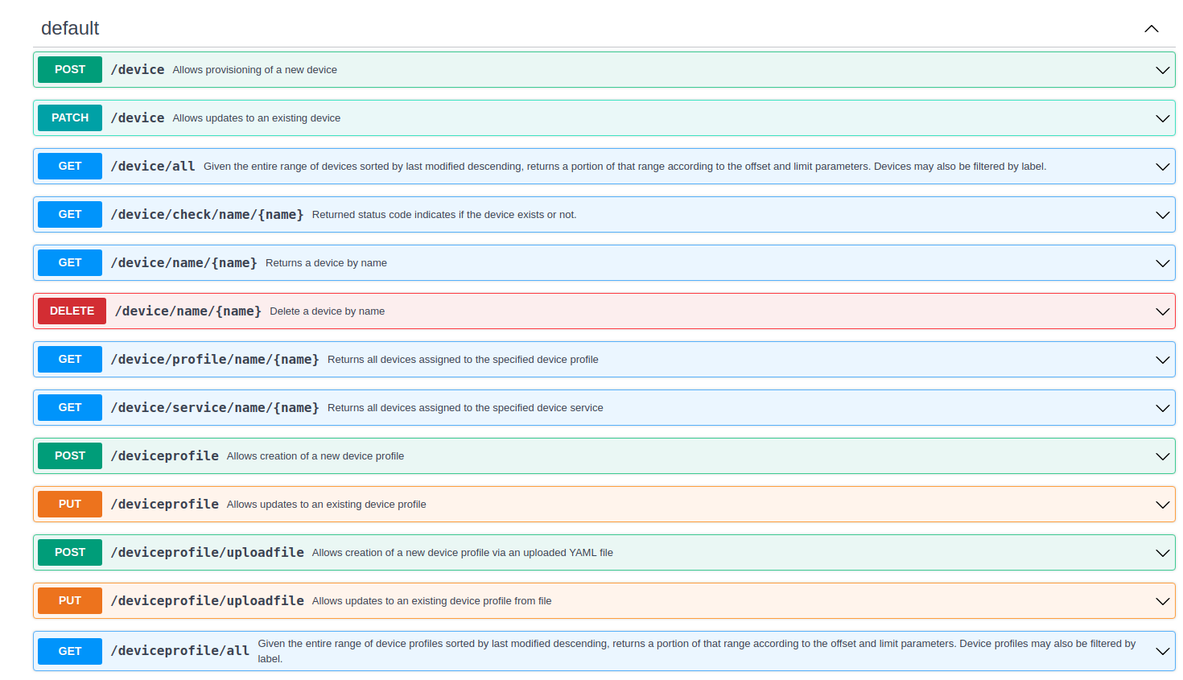
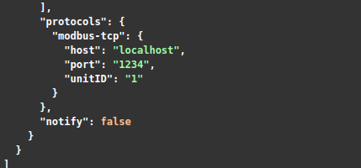
Metadata API
The Metadata microservice includes the device/sensor metadata database and APIs to expose the database to other services.
In particular, the device provisioning service deposits and manages device metadata through this service.
Notes:
https://app.swaggerhub.com/apis-docs/EdgeXFoundry1/core-metadata/2.0.0

Slide 25
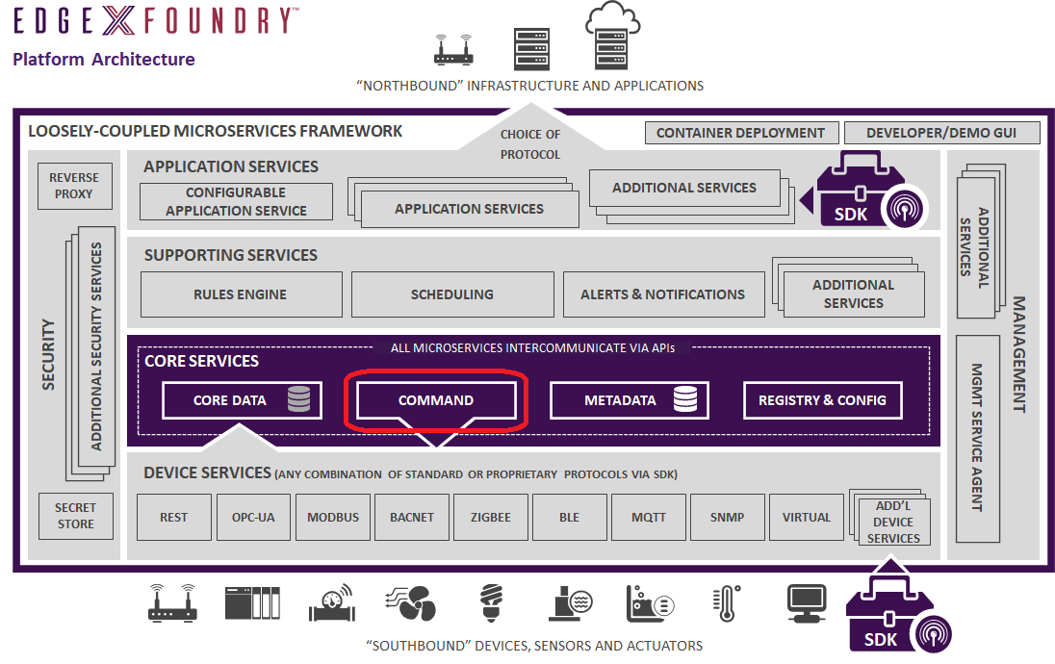
Command service
command micro service exposes the commands in a common, normalized way to simplify communications with the devices. There are two types of commands that can be sent to a device.
a GET command requests data from the device. This is often used to request the latest sensor reading from the device.
PUT commands request to take action or actuate the device or to set some configuration on the device.
The command micro service gets its knowledge about the devices from the metadata service. The command service always relays commands (GET or PUT) to the devices through the device service

Slide 26
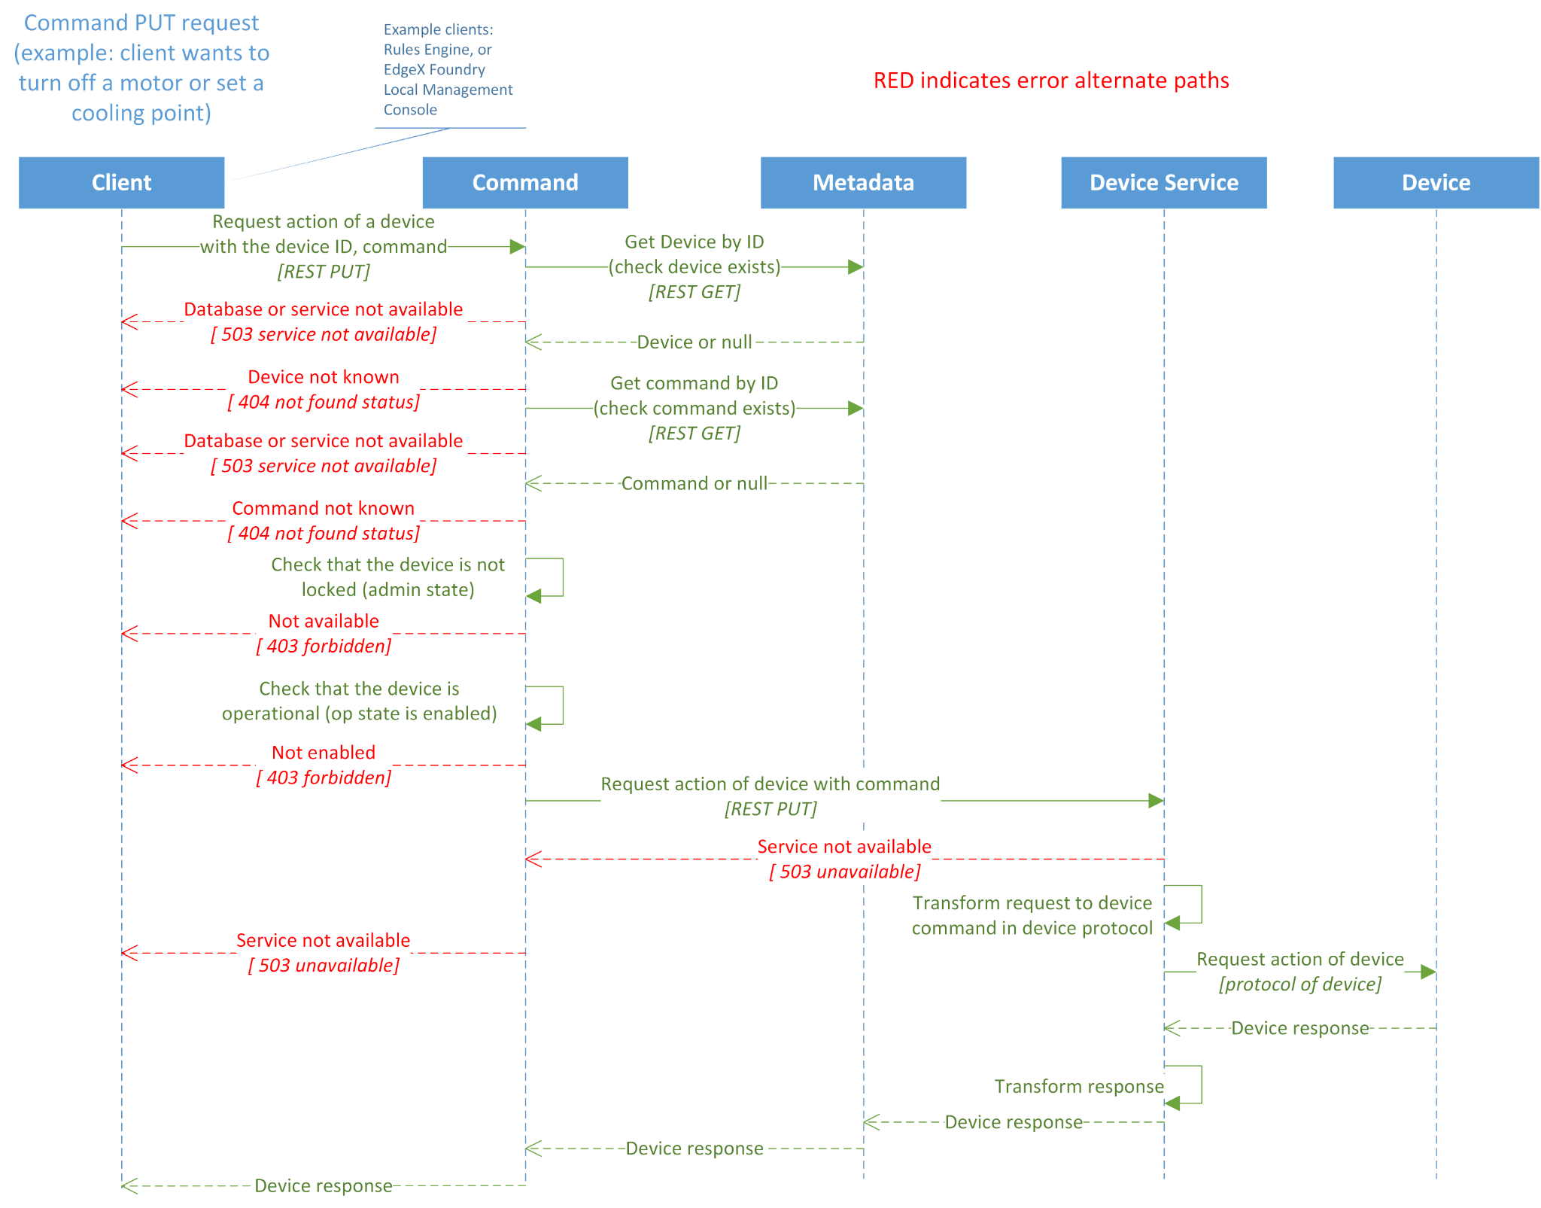
Device actuation cmd flow

Slide 27
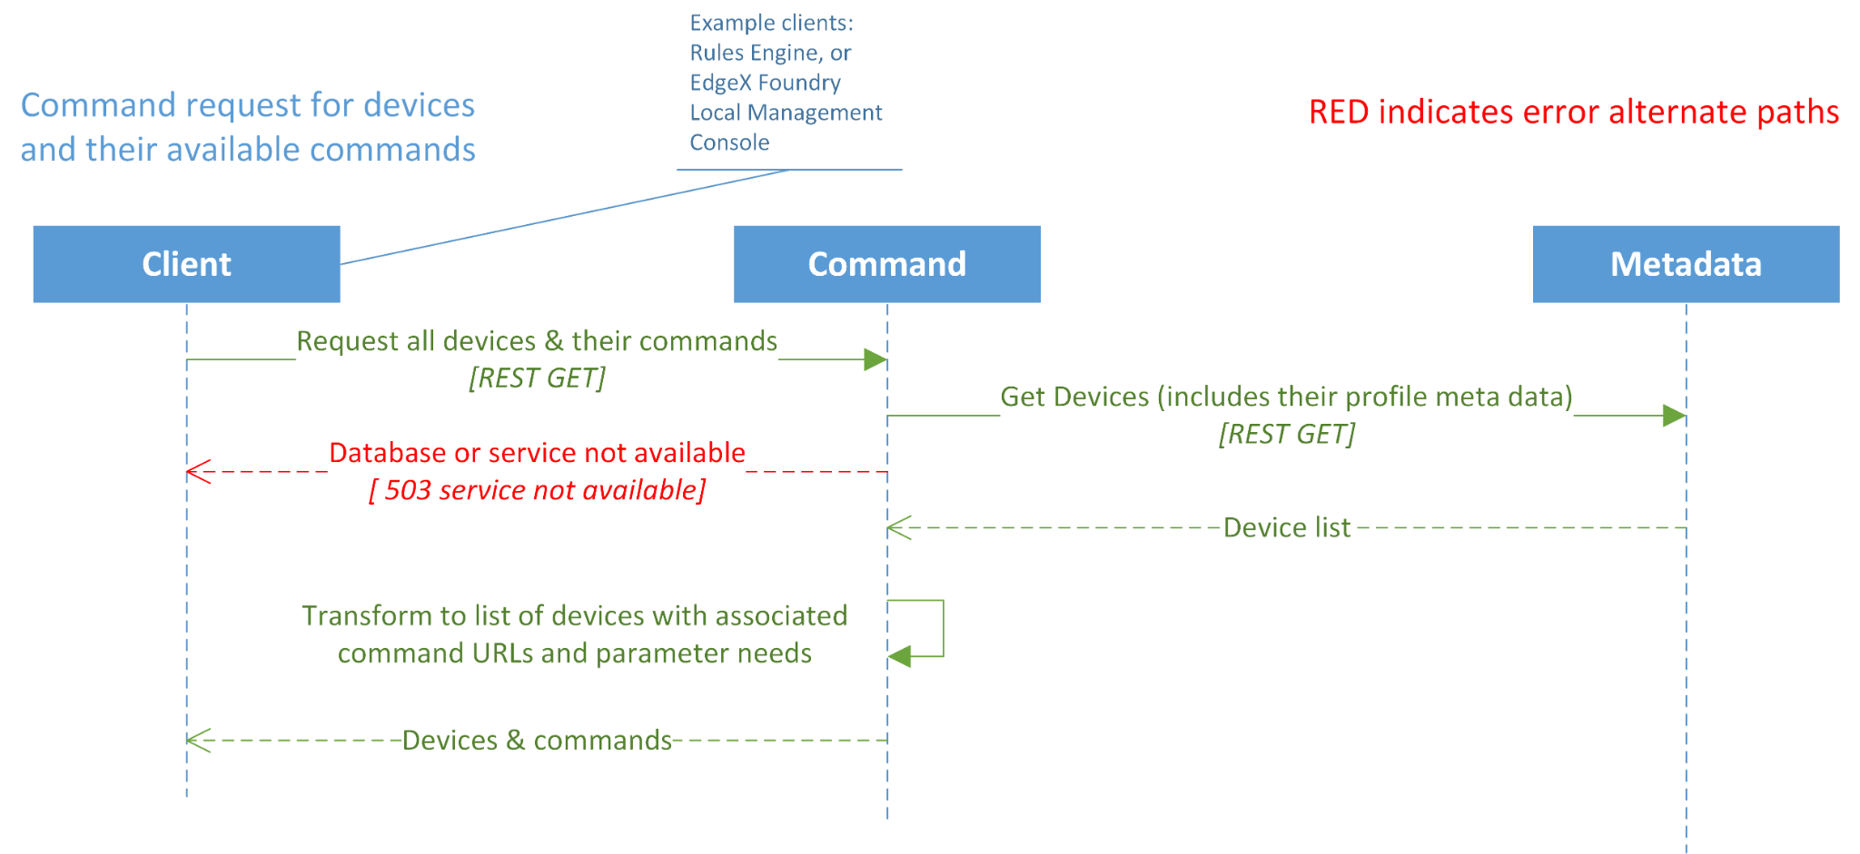
Request for Devices and Available Commands

Slide 28
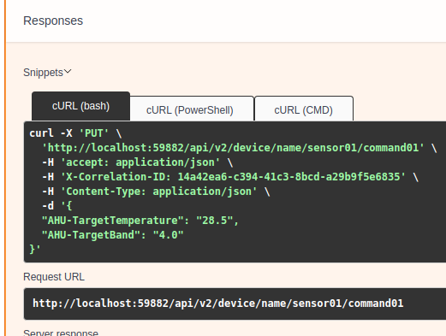
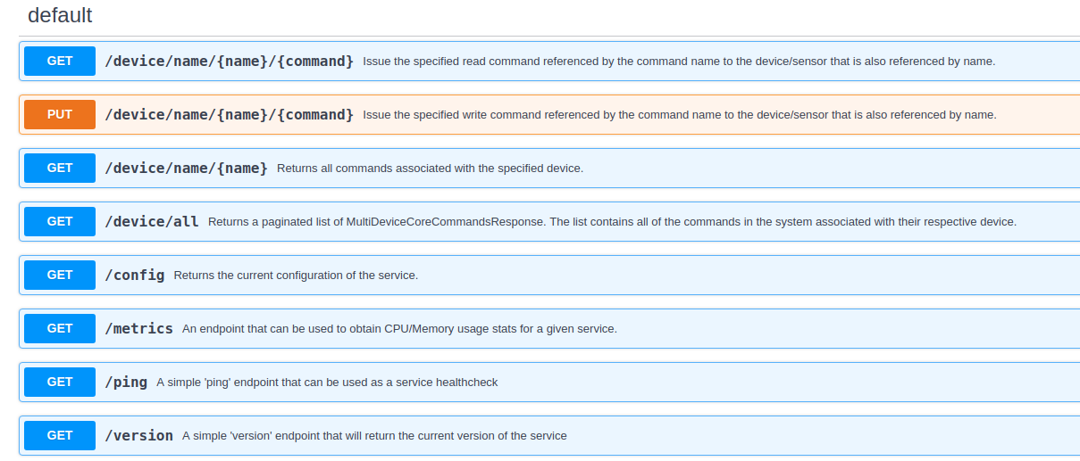
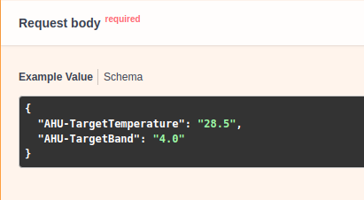
Command service API
Command to set temp

Slide 29
Device Services
All device services must perform the following tasks:
Register with core metadata – letting all of EdgeX know that it is running and stands ready to manage devices.
Get its configuration settings from the EdgeX’s configuration service (or local configuration file if the configuration service is not being used).
Register itself an EdgeX running micro service with the EdgeX registry service (when running) – allowing other EdgeX services to communicate with it.
Device provisioning, On-board and manage physical devices it knows how to communicate with.
Update and inform EdgeX on the operating state of the device (does it appear the device is still running and able to communicate).
Monitor for configuration changes and apply new configuration where applicable.
Get sensor data (i.e. ingest sensor data) and pass that data to the core data micro service via REST.
Receive and react to REST based actuation commands.

Slide 30
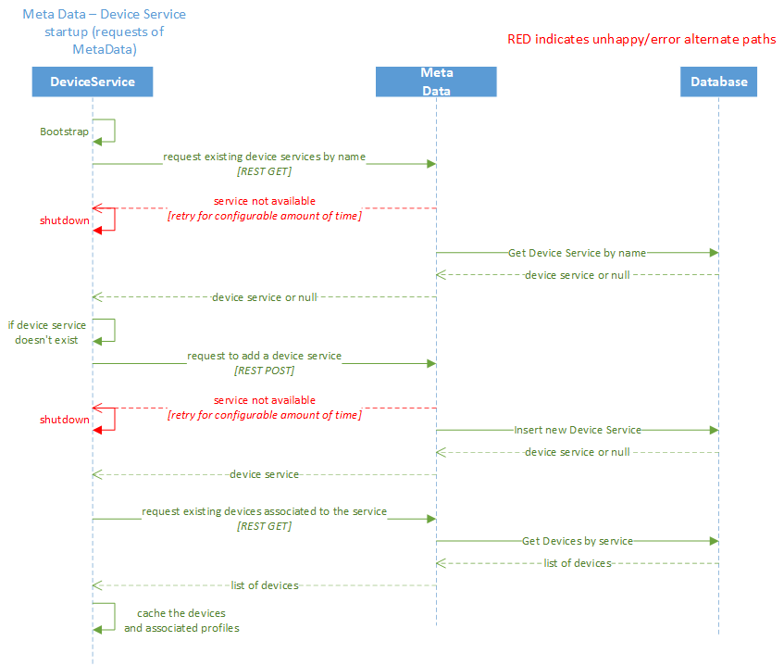
Starting device service

Slide 31
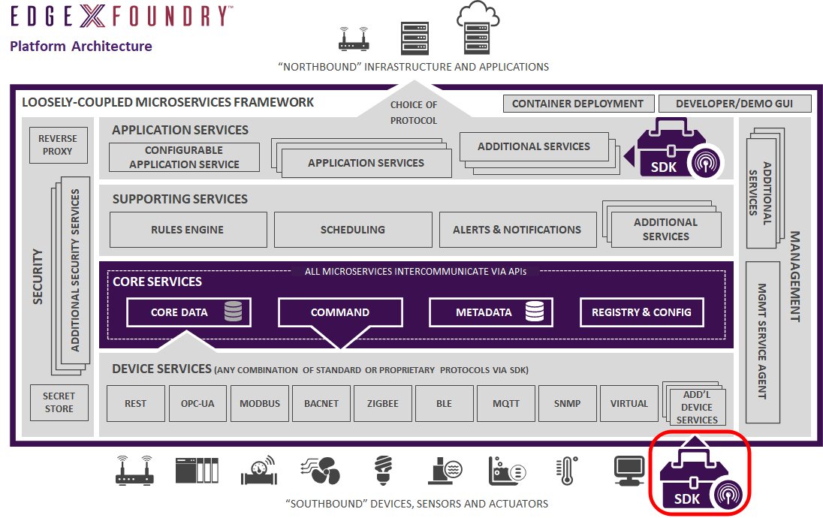
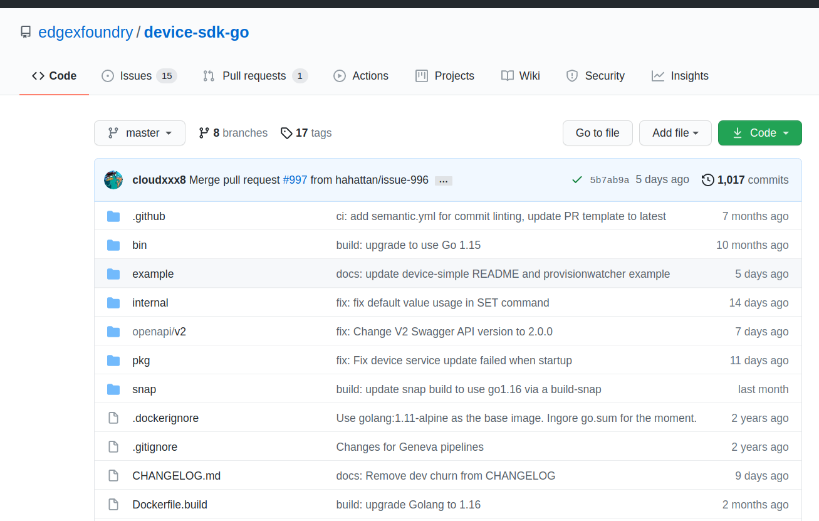
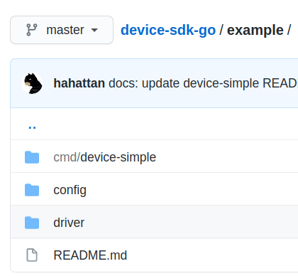
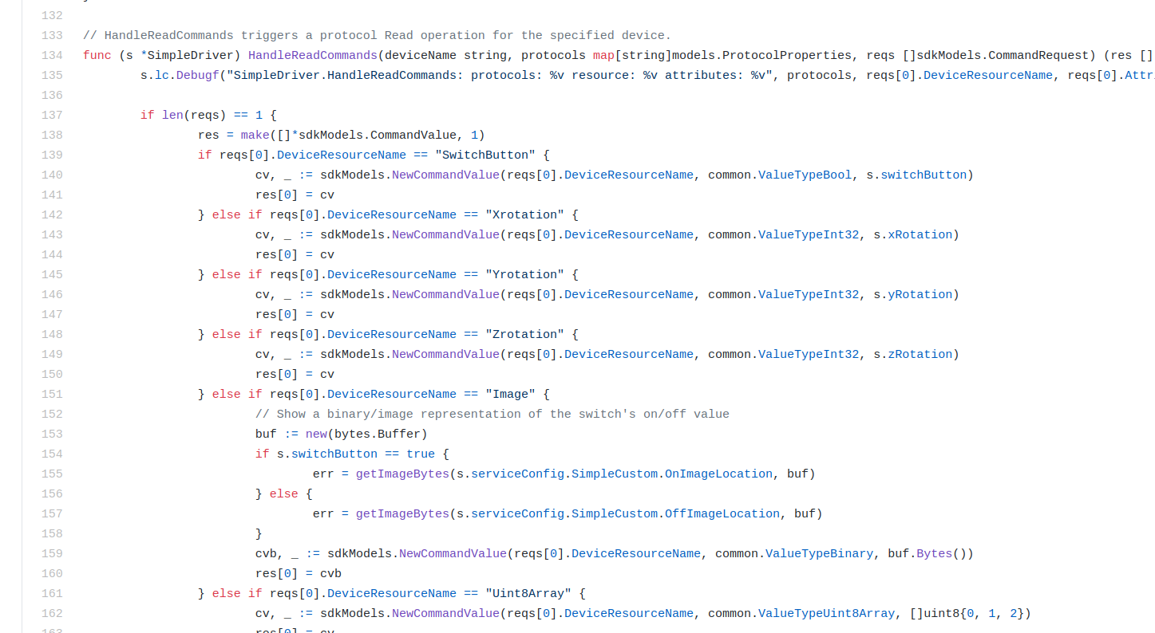
Device Services SDK
The SDKs are libraries to be incorporated into a new micro service. Include information such as initialization of the device service, getting the service configured, sending sensor data to core data, managing communications with core metadata, and much more are handled by the code in the SDK library. The code in the SDK also helps to ensure your device service adheres to rules and standards of EdgeX – such as making sure the service registers with the EdgeX registry service when it starts up.
Synchronous read and write operations
Asynchronous device data collection
Initialization and deconstruction of Driver Interface
Initialization and destruction of Device Connection
Framework for automated Provisioning Mechanism
Support for multiple classes of Devices with Profiles
Support for sets of actions triggered by a command
Cached responses to queries

Slide 32
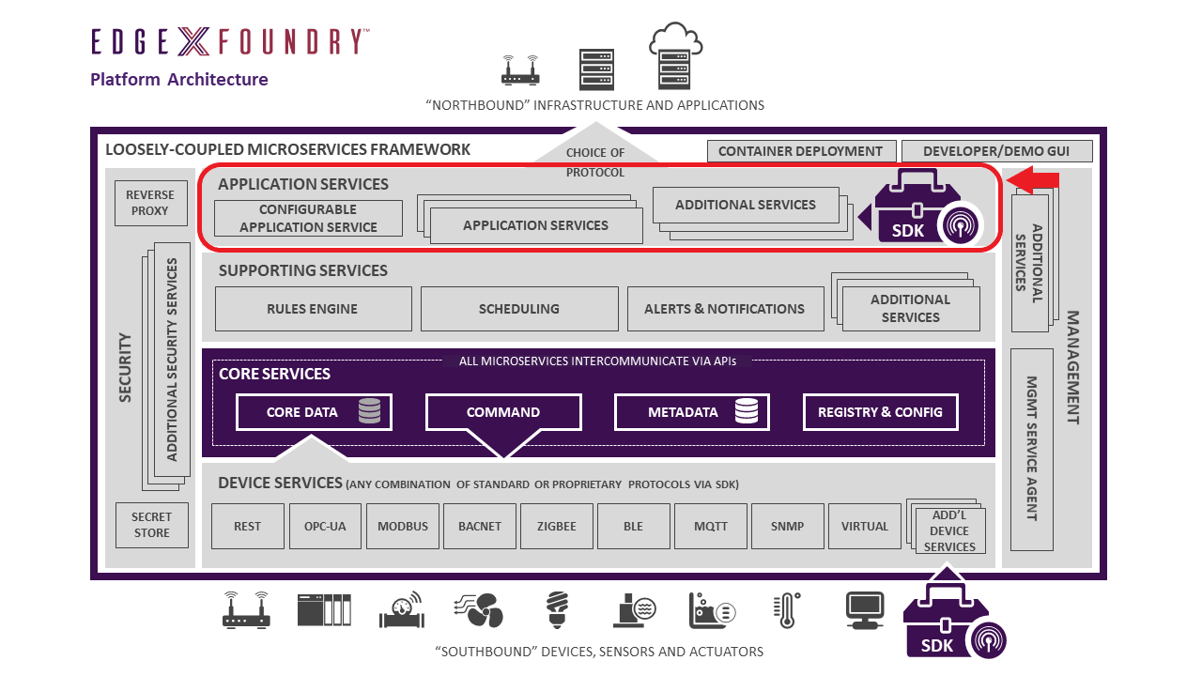
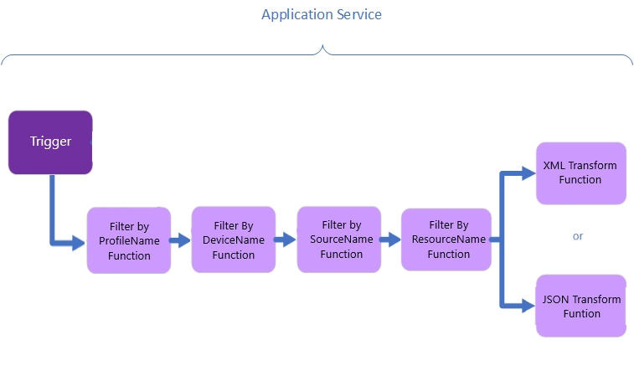
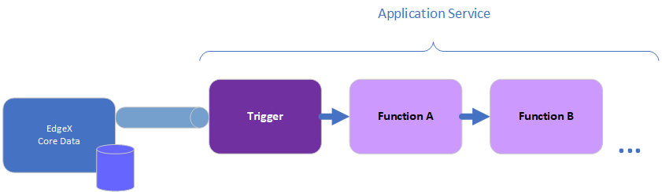
Application services
Get data from EdgeX Foundry to be processed at the edge and/or sent to external systems (be it analytics package, enterprise or on-prem application, cloud systems like Azure IoT, AWS IoT, or Google IoT Core, etc.).
Provide the means for data to be prepared (transformed, enriched, filtered, etc.) and groomed (formatted, compressed, encrypted, etc.) before being sent to an endpoint of choice or published back to other Application Service to consume.
Application Services are based on the idea of a "Functions Pipeline". A functions pipeline is a collection of functions that process messages (in this case EdgeX event/reading messages) in the order that you've specified

Slide 33
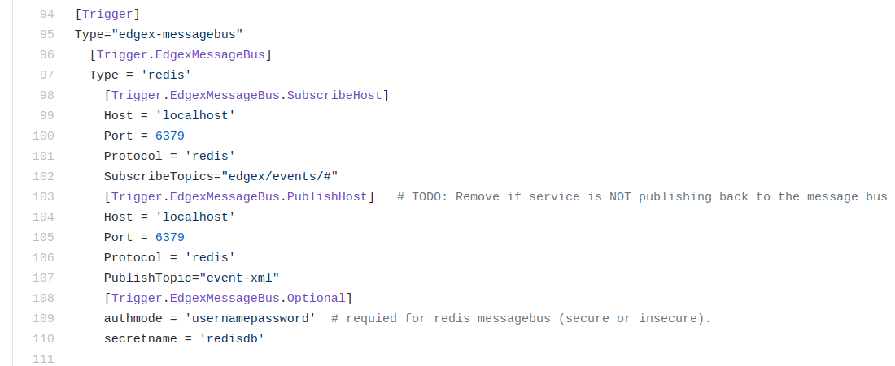
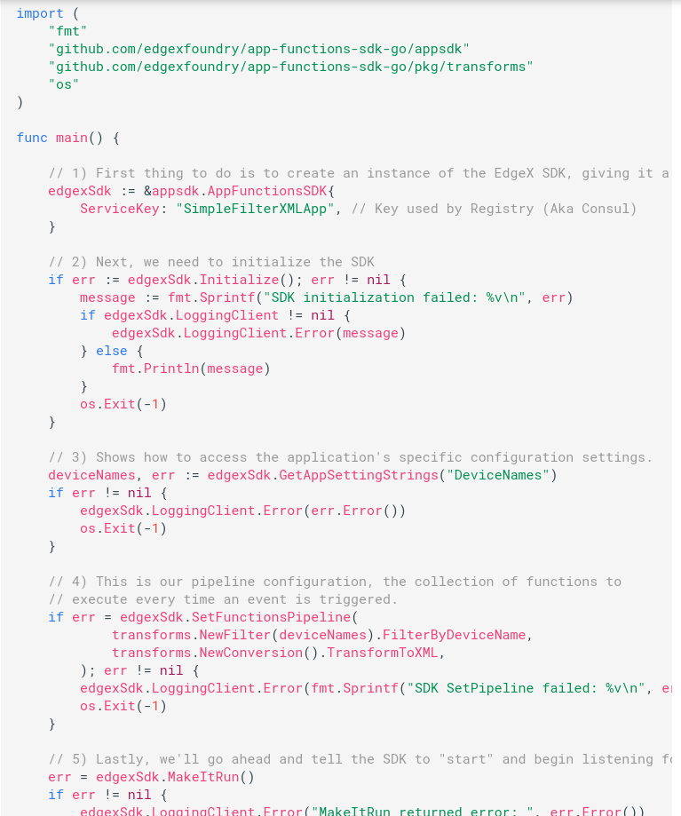
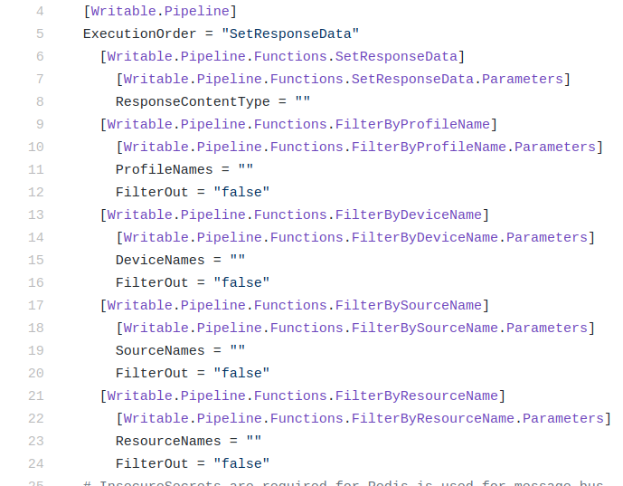
Application SDKs
Config TOML file for source and sink of events
The SDK is built around the idea of a "Functions Pipeline".
A functions pipeline is a collection of various functions that process the data in the order that have specified.
The functions pipeline is executed by the specified trigger in the configuration.toml

Slide 34
Summery
IOT protocol support and Device SDK | Most of IOT protocol support by device services in github. New device service can be added for specific devices/protocol Device service SDKs for quickly develop new service for support new device/protocol Device services are in GO lang
Device command support | Mature system for control the devices by maintaining devices profiles and states in Metadata Good Close loop support: local analytics and feedback to devices
Device Metadata | Maintain device profiles for communications, device states and relation between profiles and device services Focus on Rich set of templates for devices attributes
Application services for North Interface | To export data to third party systems like servers, data center or cloud, example application services supported Application SDKs for for quick develop and support new cloud or servers
Filters and transforms | Framework provided in configuration to filter and transform data by application service
Distributed architecture | Loosely coupled arch and Registry of micro services for registry and discovery by Consul Microservices can be deployed at different layers
Enhance Data transfer | Supported and Enhancing data transfer by supporting PUB-SUB for data flows including REST among internal services Central Message Queue for microservices communications and data transfer.
Rules Engine and Notifications | Default Kuiper rules engine supported for basic analytics Notification can be send to email/slack/hangout/communicate a message
What Edgegllery can borrow:
Code is in GO lang which is align with Edgegllery MEP
Device and North interface SDKs for quick development for support new devices/Protocols and cloud
Rich and mature system for device control compare to Fledge.(Device metadata)
Kuiper Rule engine for basic analytics and can add new analytics

Slide 35
Backup slide

Slide 36

Notes:
https://enterpriseirregulars.com/138763/seven-things-you-need-to-know-about-iiot-in-manufacturing/
https://www.biz4intellia.com/industrial-iot/
https://www.iotworldtoday.com/2017/09/20/top-20-industrial-iot-applications/

Slide 37


Slide 38
How to deploy edgeX -- k8s yaml
How to configure new devices/profiles
How user applications read/write data from
Notes:
https://docs.edgexfoundry.org/1.3/examples/LinuxTutorial/EdgeX-Foundry-tutorial-ver1.1.pdf

Slide 39


